Slide 1
Video Game Industry Analyses
By Richard Pountney

Slide 2
Before the first Gen of home consoles
There were old fashion PCs that are very primitive compared to modern-day ones.
In 1945 John von Neumann wrote the First Draft of a Report on the EDVAC
He outlines the architecture of a stored-program computer, this included electronic storage of programming data & information. This would eliminate the need for the more clumsy methods of programming such as plugboards, punched cards & paper.
In 1947 The first bug was found
Grace Hopper records what she jokingly called the first actual computer bug. This was a moth stuck between relay contacts of the Harvard Mark II.
Grace Hopper served on the committee to develop COBOL, which is a standard & widely adopted programming language that had transformed the way software was developed for business applications. COBOL is still used today

Slide 3
Before the first Gen of home consoles continued
1948 was when the first program to run on a computer happened.
1949 was a big accomplishment in technology, this is because:
Magnetic core memory was developed. This was the first reliable high-speed random-access memory (RAM). This was used well into the 1970s.
The Electronic Delay Storage Automation Calculator (EDSAC) was constructed & Completed.
In 1952 OXO was made.
OXO is a version of tic-tac-toe that was written on the EDSAC.
It used rotary telephone dials to enter the moves from the player.
The game board display was a 35x15 dot cathode ray tube.
The player was able to choose who would make the first move (the player or the machine)

Slide 4
Before the first Gen of home consoles continued
1954 was the first time seeing a controller consisting of a joystick & knob was developed. This was developed by William Brown & Ted Lewis. This was to demonstrate the MIDSAC computer with a program pool.
1956 was when research started for Direct keyboard input to computers.
In 1958 the game Tennis for Two was made. This was the first game to use multiple controllers.
In 1962 the game Spacewar! Was developed. This was the first video game to be played on multiple computer installations.

Slide 5
First Generation of Home Consoles
This would include video games & game consoles released between 1972 & 1983
This generation was pioneered by companies like Magnavox (Odyssey), Nintendo (Color TV-Game 6) & Atari (Home Pong).
The first system/game in 1972 was Odyssey.
These used television as the display outputs
Some were capable of displaying coloured graphics.
The games were programmed directly onto the hardware
Some of these used plastic overlays on the screen to give additional graphics.

Slide 6
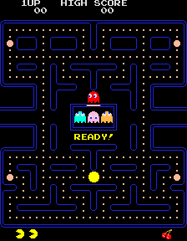
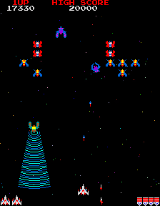
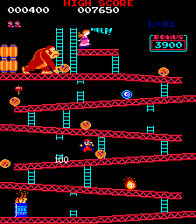
The Golden Age of Arcade Games
Between the late 1970s & early 1980s there was a period of rapid growth of technological advancement & cultural influence of arcade games.
This was the transition from black&white graphics to colour graphics.
When racing games were done it was done in 3D perspective (in 2D space).
Full-motion video was introduced here as well.
Some of the know Arcade Games:
Space Invaders
Galaga
Asteroids
Pac-Man
Frogger
Donkey Kong

Slide 7
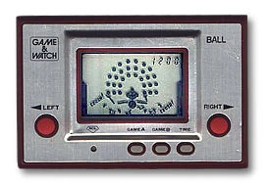
Second Gen of Home Consoles
This Gen includes games & consoles released between 1976 – 1992.
This coincides with the ‘Golden age’ of arcade games.
Early cartridge-based technology.
Improved screen, colour, audio & AI compared to the previous gen.
Consoles:
Atari 2600
ColecoVision
Magnavox Odyssey 2
Mattel Intellivision
Microvision
Game&Watch

Slide 8
The Video Game Crash of 1983
The global market fell to 1/3 of its original value.
Multiple companies either went bankrupt or left the games industry including some leading ones.
Large quantities of poor-quality games were created. Which was a result of inexperienced programmers being backed by inexperienced capitalists attempting to capitalise on the industry.
Home computers became as inexpensive as game consoles.

Slide 9
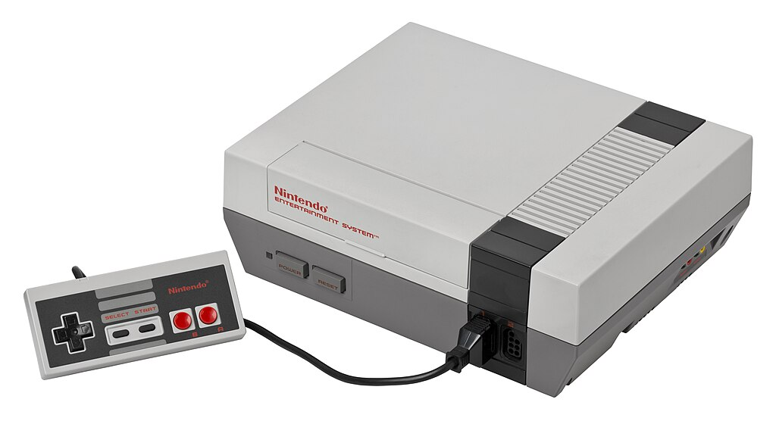
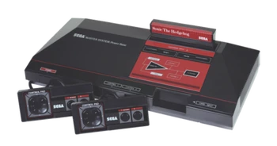
Third Gen of Home Consoles
This Gen includes games & consoles released between 1983 – 1995. This Gen was also referred to as the ‘8-bit era’
Improved graphics via larger resolutions, increased colour pallets, & improved pseudo-3D.
(censorship history)
Consoles:
Nintendo Entertainment System (NES or Famicom)
Sega Master System
Atari 7800

Slide 10
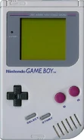
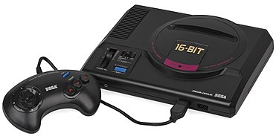
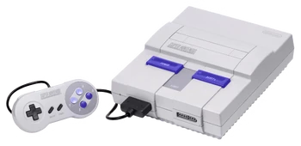
Fourth Gen of Home Consoles
This Gen includes games & consoles released between 1987 – 1996 This Gen was also referred to as the ’16-bit era’
16-bit microprocessors, 16-bit colour palettes (which provided up to 65,536 different colours)
Stereo audio was introduced, which allowed for separate left & right channels.
Controllers featured more inputs than the previous gen.
Consoles:
Sega Genesis/Sega Mega Drive
Super Nintendo Entertainment System (SNES)
Nintendo Game Boy
Neo Geo

Slide 11
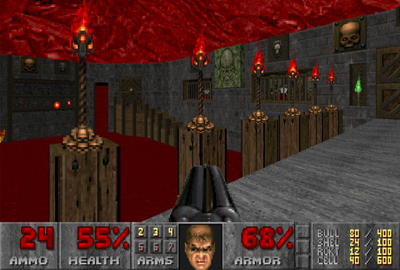
Introduction of 3D Graphics
Texture mapping & 3D lighting which allowed for 3D polygonal graphical rendering in real-time.
this replaced the 2.5D graphics that were used to emulate 3D graphics.
iD software made one of the first game engines that separated the gameplay & rendering from each other.
Some early 3D games:
Virtua Racing (Sega AM2)
Hovertank 3D (iD Software)
Catacomb 3-D (iD Software)
Wofenstein 3D (iD Software)
Doom (iD Software)
Ultima Underworld (Blue Sky Productions)
Duke Nukem 3D (3D Realms)
Marathon (Bungie)
Quake (iD Software)

Slide 12
What I call the Doom crash
The game Doom caused a network crash when it was initially released.
This was because of how many people tried to download it at once which caused an overload on the network causing it to crash.

Slide 13
The impact of 3D Graphics
Thanks to 3D graphics, a lot of the industry started moving towards mostly using 3D assets in their games.
Though the hardware at the time was still limiting what could be done.

Slide 14
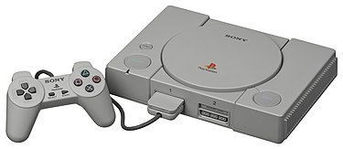
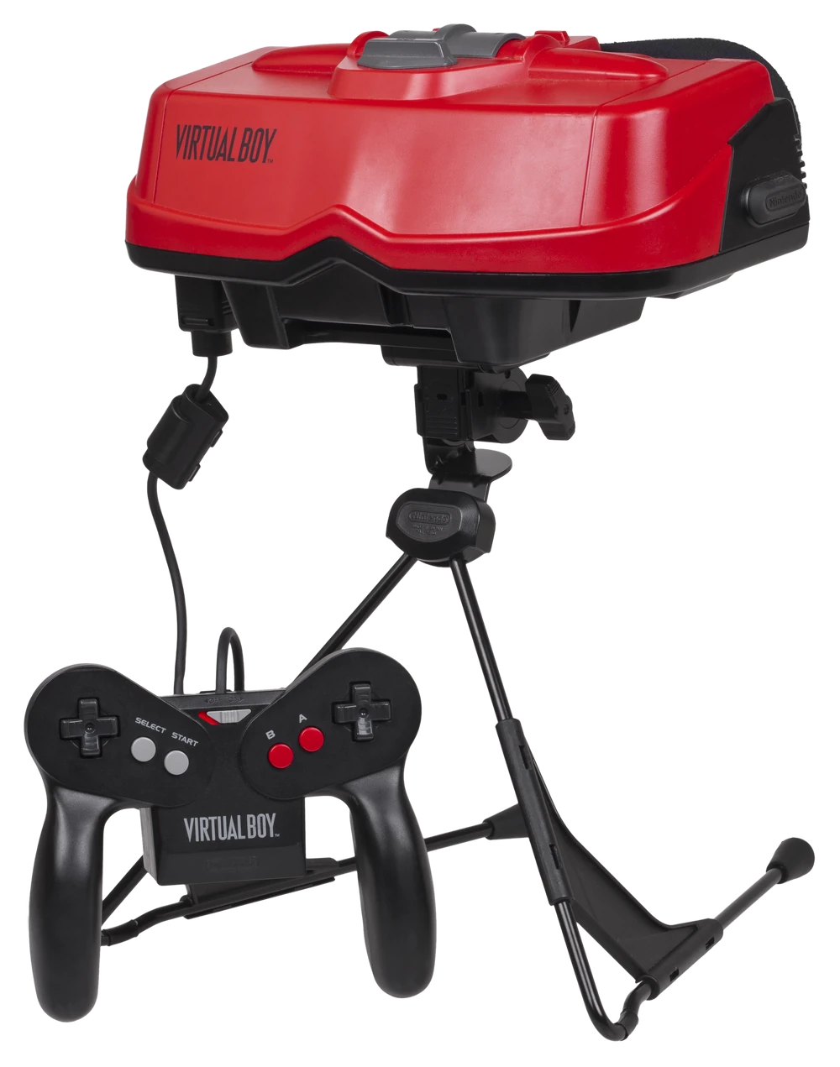
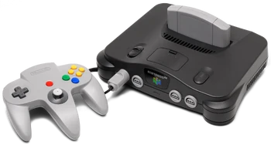
Fifth Gen of Home Consoles
This Gen includes games & consoles released between 1993 – 2000 This Gen was also referred to as the 32-bit or 64-bit era
3D games become prevalent.
Most companies transitioned to storing games on CDs except for Nintendo who stayed with cartridges.
Analogue joysticks on controllers started being prevalent.
CD-quality audio was being used.
Consoles:
Sony PlayStation
Nintendo 64
Nintendo Virtual Boy (The predecessor of all VR)
Nintendo Game Boy Color
Sega Saturn

Slide 15
1990’s
PC gaming gains more traction
Emergence of game genres
Modding communities started to grow

Slide 16
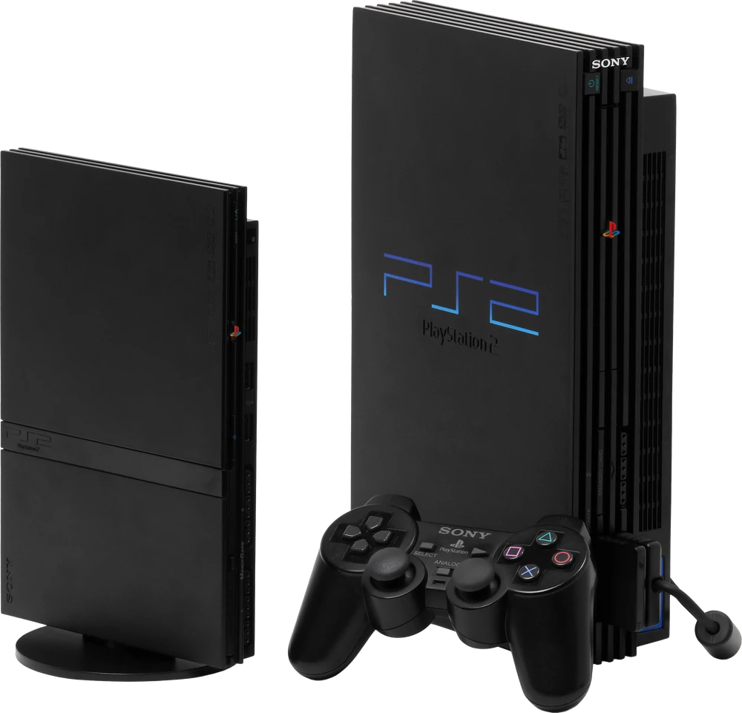
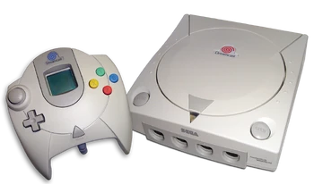
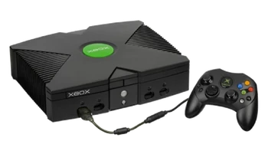
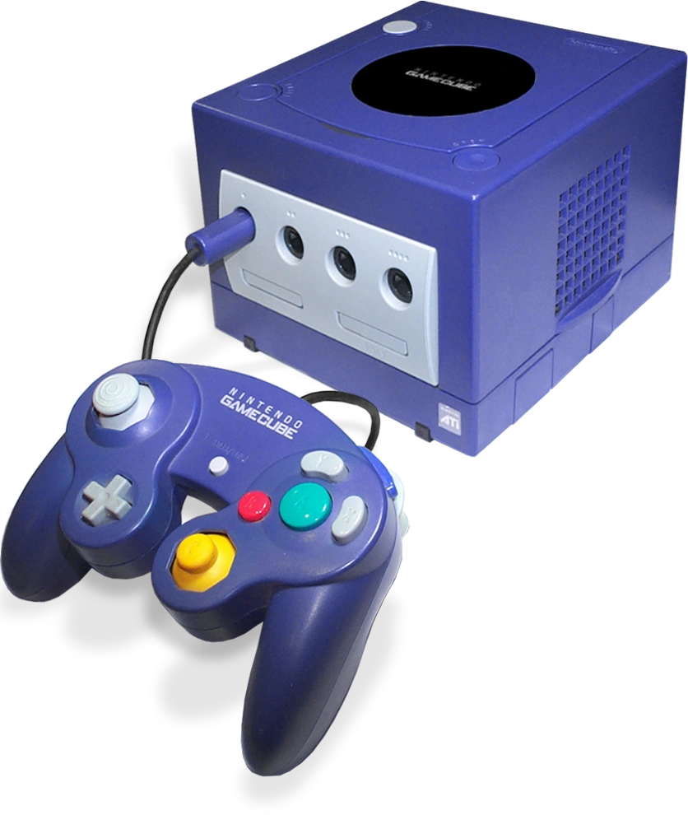
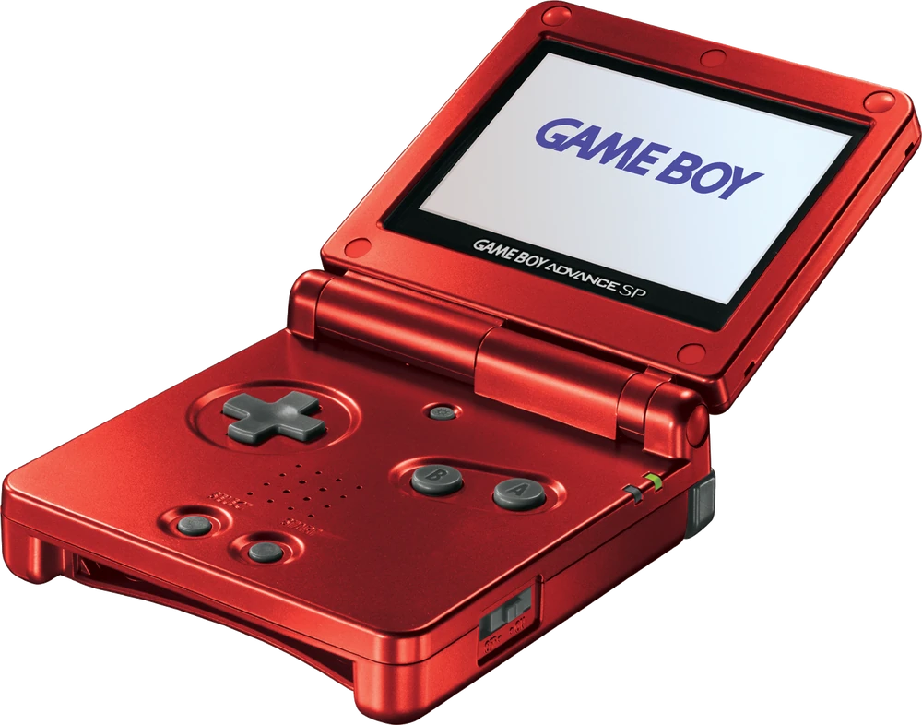
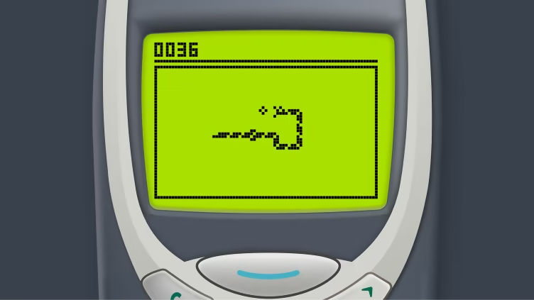
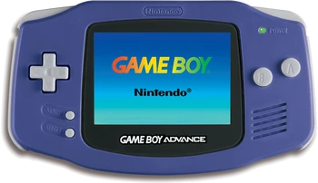
Sixth Gen of Home Consoles
This Gen includes games & consoles released between 1998 – 2013 This Gen sometimes is referred to as the 128-bit era
In 2000 China bans game consoles
Online gaming services start becoming accessible
Full online gaming experience (Xbox Live)
Game download directly over the internet.
Saving games directly to a hard disk had become possible.
First phone game Snake was introduced by Nokia phones.
Consoles:
Sega Dreamcast
Sony PlayStation 2
PlayStation 2 Slim
Nintendo GameCube
Microsoft Xbox
Nintendo Gameboy Advanced (& SP)

Slide 17

Digital Market
The Digital Market was created as a way to distribute updates to published games & to implement stronger anti-cheat & anti-piracy measures.
2003 was the Launch of Steam which was created to publish & distribute games made by Valve on PC.
In 2005, negotiations started for third-party publishers to distribute their games on Steam.
From 2007 onward, Larger publishers distribute their games on Steam.
There were 13 Million Steam accounts created & 150 games were available for purchase by May 2007.
In 2012 & onwards, AAA publishers started creating their own digital platforms.

Slide 18
Impacts of Digital Markets
Thanks to digital markets, games had gotten easier to obtain because you didn’t need to always go to stores to search for the game you wanted.
Digital Market platforms/applications have layouts that are good to navigate through & to access what you’d need.
The hardware limitations are the hardware components in your computer.
The software limitations are the app version & if it is compatible with your system software.

Slide 19
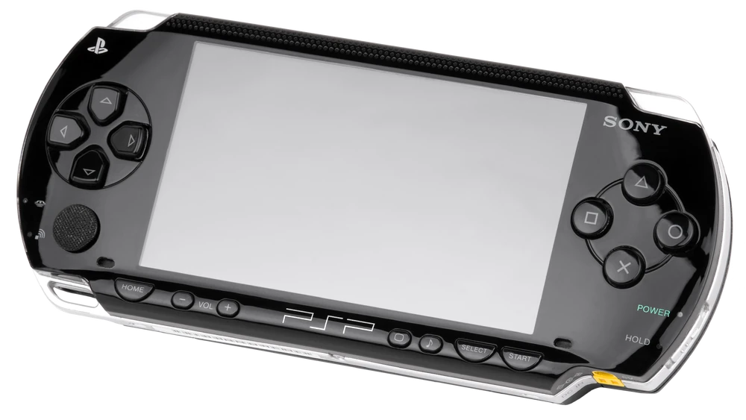
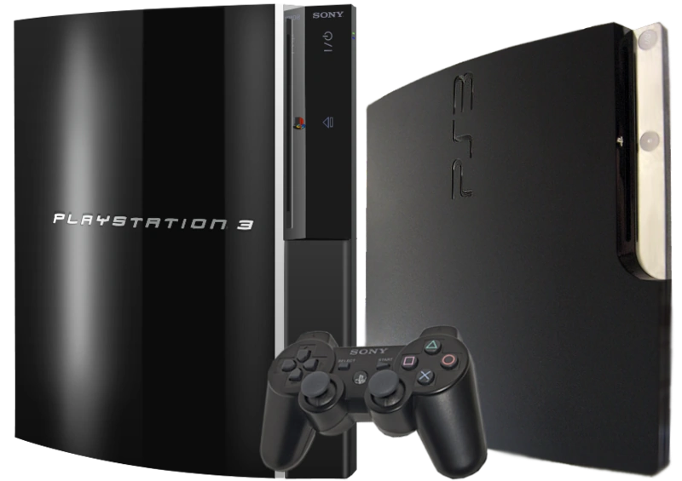
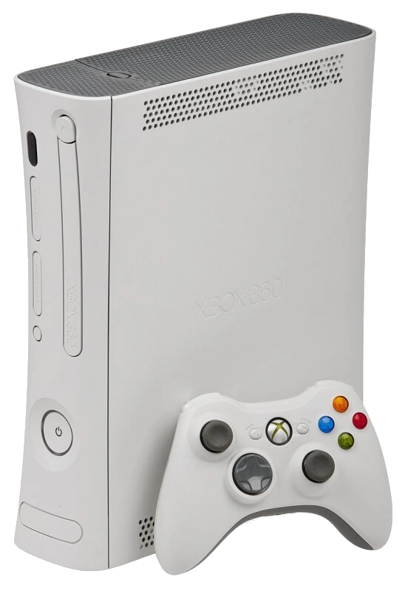
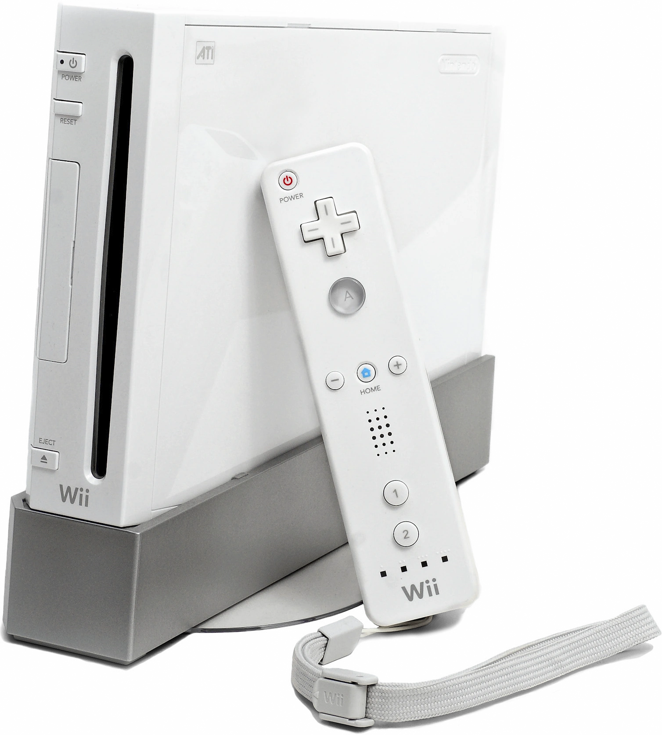
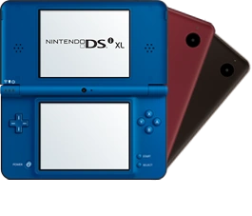
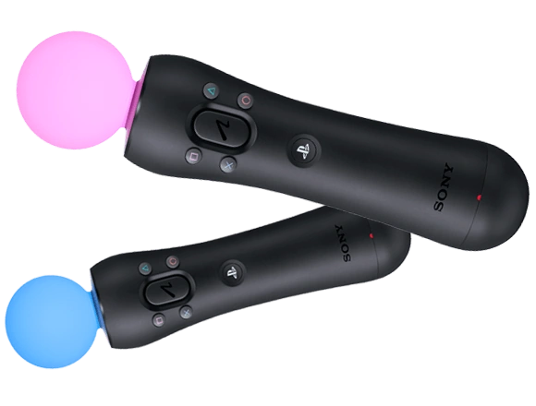
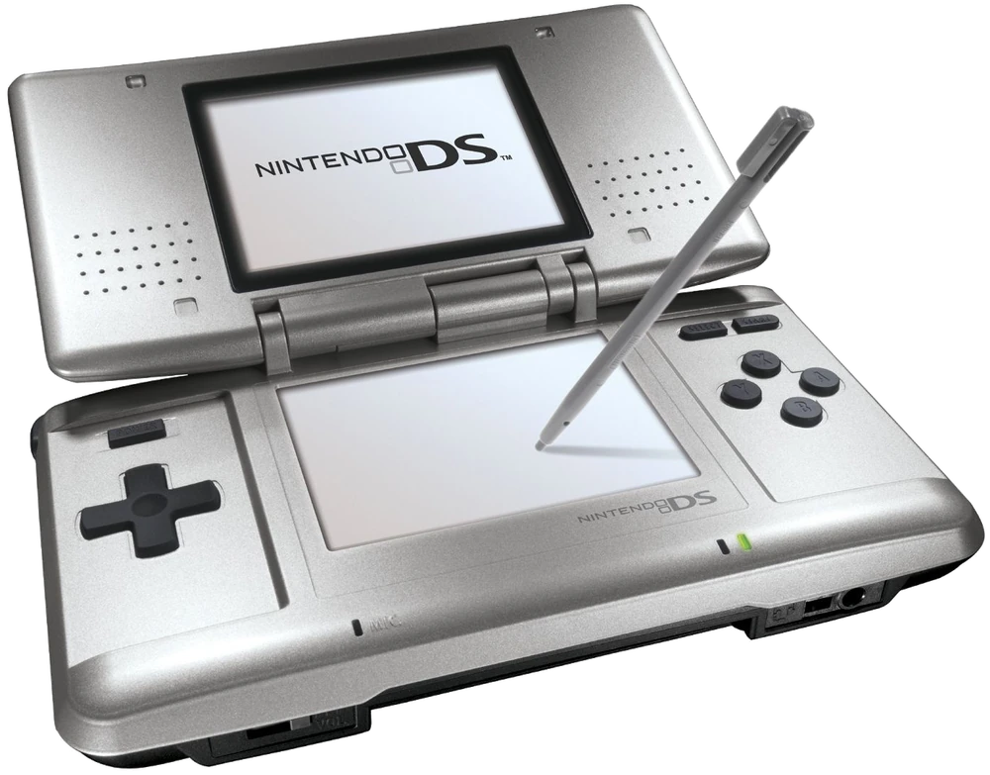
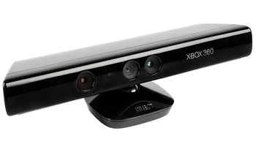
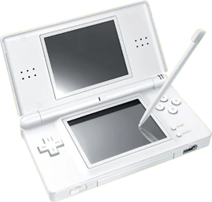
Seventh Gen of Home Consoles
This Gen includes games & consoles released between 2005 – 2017
Gaming with Motion-sensing became popular. The motion sensors are PlayStation Move, Xbox Kinect & the Wii (the Wii remote & Inferred sensor)
Sony included a native 3D Blu-ray disc player in their consoles.
Microsoft offered games that were natively rendered in HD resolution on their console.
Nintendo marketed its console to hardcore, casual, & non-gamers.
Consoles:
Microsoft Xbox 360
Sony PlayStation 3 (PS3)
Sony PlayStation Portable (PSP)
Nintendo Wii
Nintendo DS
DS Lite
Nintendo DSi
DSi XL

Slide 20
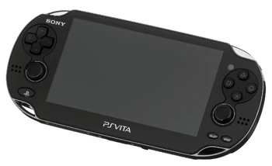
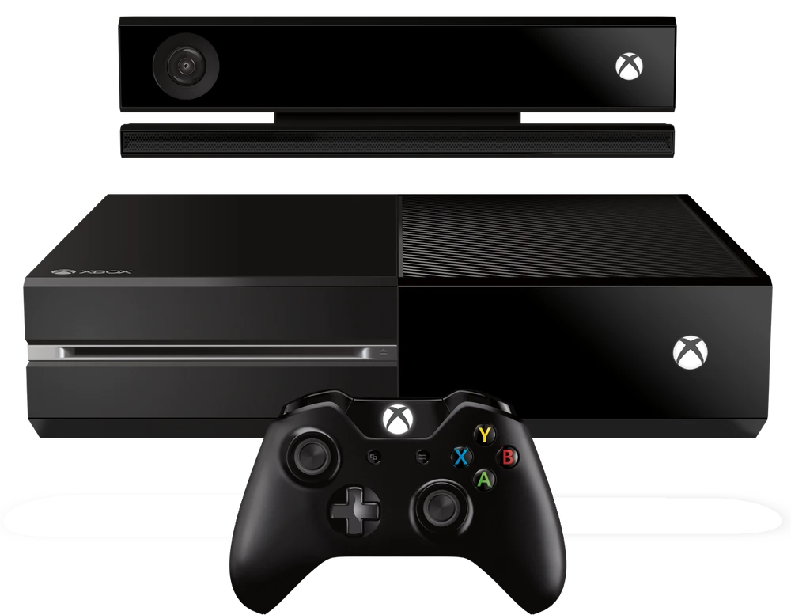
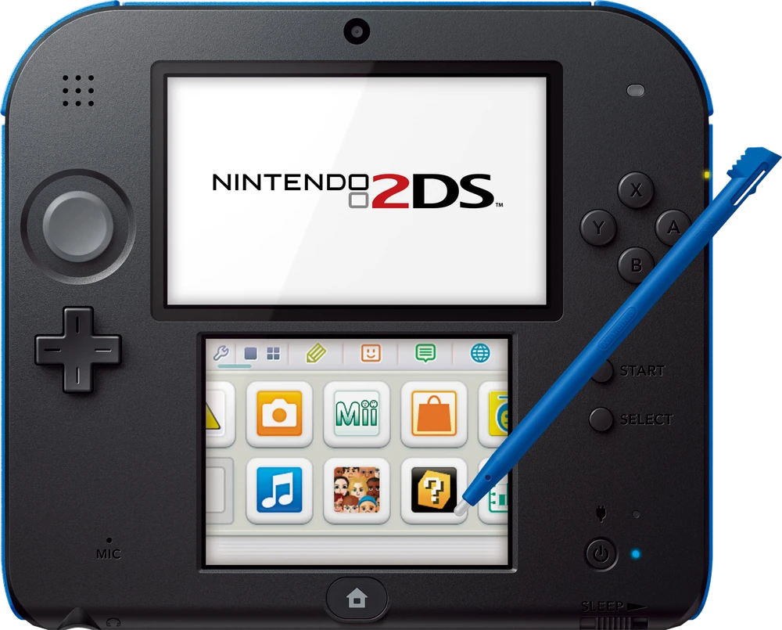
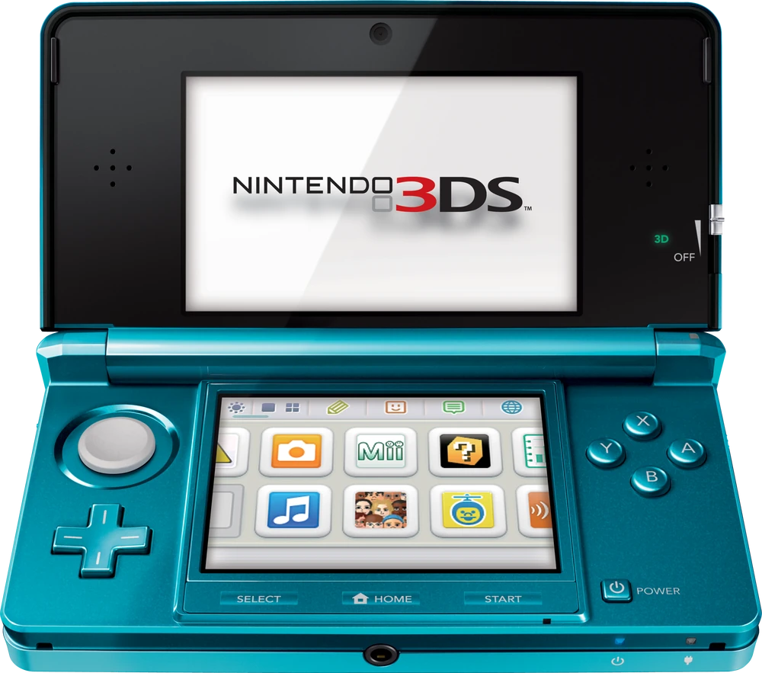
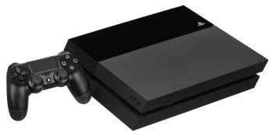
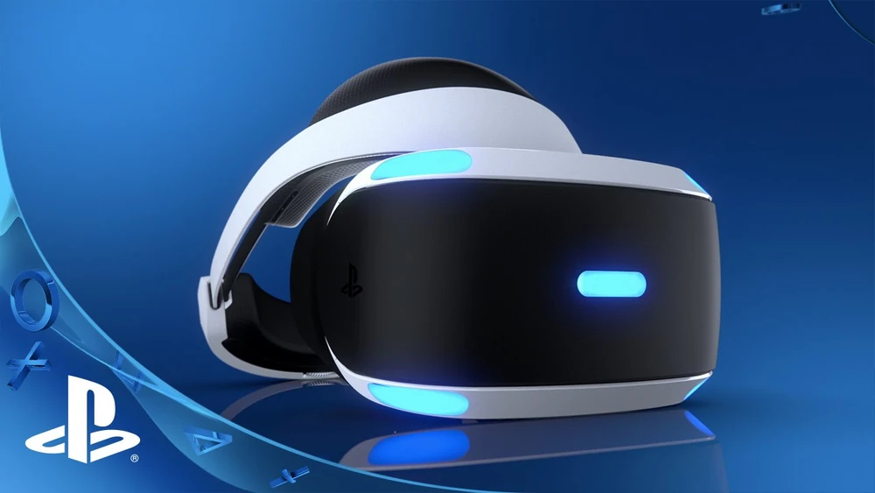
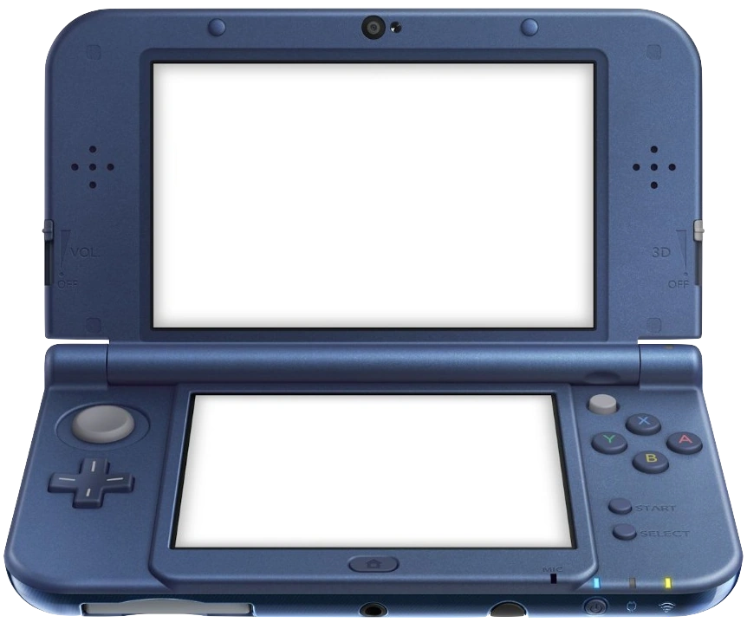
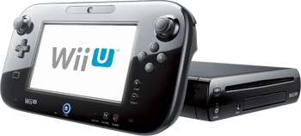
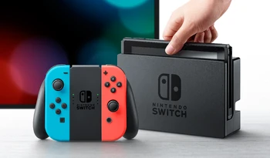
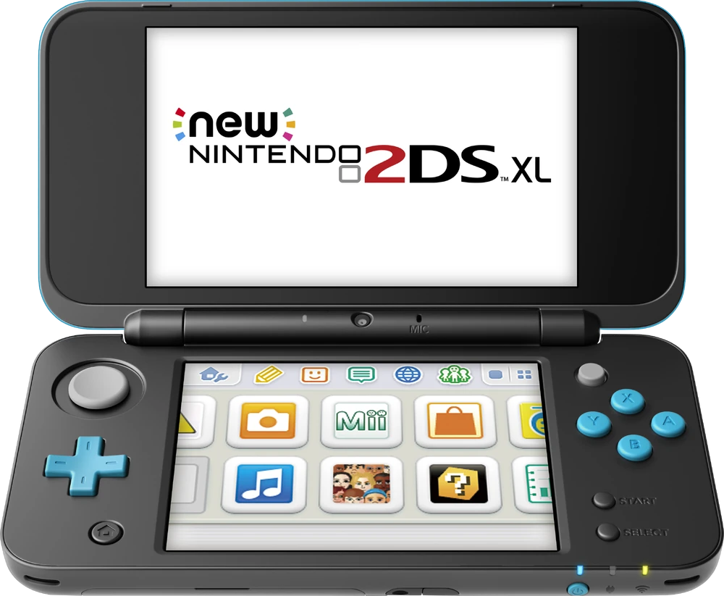
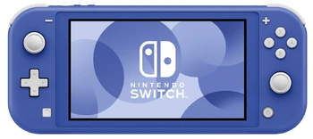
Eighth Gen of Home Consoles
Consoles:
Microsoft:
Xbox One
Xbox One X
Kinect 2.0
Sony:
PlayStation Vita
PlayStation 4 (PS4)
PlayStation 4 Slim
PlayStation 4 Pro
PlayStation VR (PSVR)
Nintendo:
Wii U
3DS
2DS
3DS XL
New 3DS
New 3DS XL
New 2DS XL
Switch
Switch Lite
This Gen includes games & consoles released between 2012 – Present
A Lage focus of this gen is digital distribution & games as a service.
Virtual Reality (VR) started emerging & gaining more focus as the future of gaming technology
Cloud gaming was becoming more used because it allowed users to run their games on remote servers & stream them to their devices.
Upgraded/alternate versions of the consoles got released mid-gen.
Mobile gaming started gaining more traction, eroding the handheld console market.
2015 China lifts their ban on video game consoles.
Micro-consoles start getting released.

Slide 21
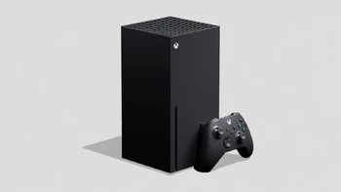
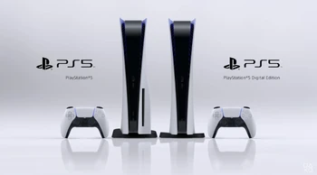
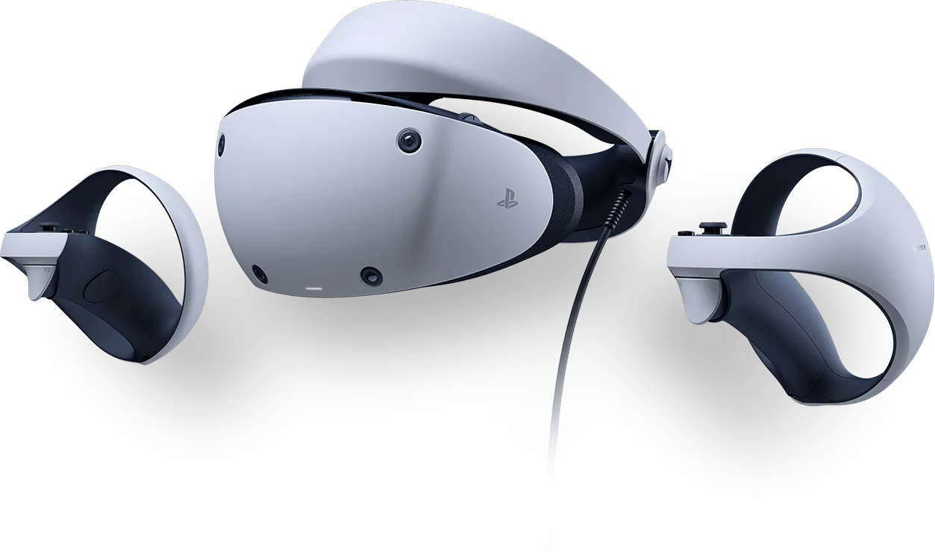
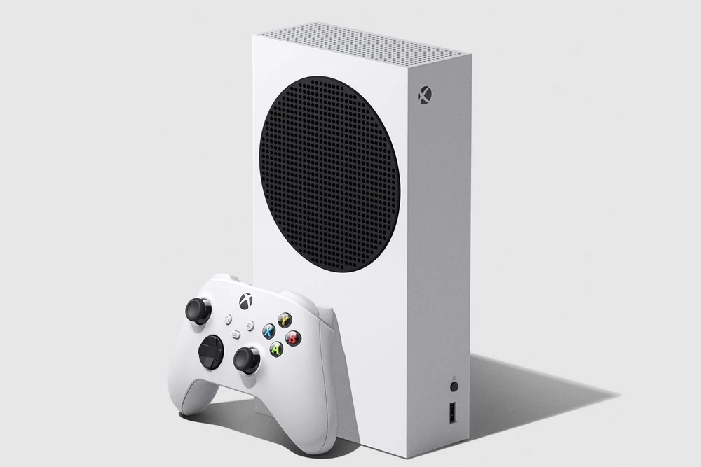
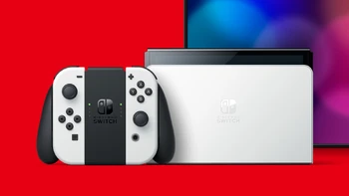
Ninth Gen of Home Consoles
Consoles:
Sony PlayStation 5 (PS5) (this includes a digital-only version as well)
Sony PlayStation VR2 (PSVR2)
Microsoft Xbox Series X/S (the S being the digital-only)
Nintendo Switch OLED
This Gen includes games & consoles released between 2020 – Present
Cloud gaming continued to evolve
Digital-only versions of the consoles are available
Backward compatibility became more known about & focused on.
Big performance upgrades via:
Reduction of load times by integrating SSDs (Solid State Drives)
Faster computing & rendering because of the improved hardware
Real-time ray tracing
Ultra HD display resolution support.

Slide 22
The Future of the Games Industry
Virtual Reality (VR) & Augmented Reality (AR) continue to make more immersion & functional for gaming & productivity.
Gameplay & game design principles will continue to be used across other industries to make them more engaging experiences.
Games use more storage so the need for larger storage drives increases.
Game expansions getting more common.
More common virtual live events.

Slide 23
References for information.
Before the first gen of home consoles:
https://www.computerhistory.org/timeline/1945/
https://www.computerhistory.org/timeline/1947/
https://www.computerhistory.org/timeline/1948/
https://www.computerhistory.org/timeline/1949/
https://www.computerhistory.org/timeline/1952/
HistoryOfVideoGames PDF from the learning content on Blackboard.

Slide 24
References For the Images
Arcade Games:
PacMan
Donkey Kong
Galaga
Gen 2:
Game&Watch Ball
Gen 3:
NES
Sega Master System
Gen 4:
SNES
Game Boy
Sega Mega Drive
3D Graphics:
Doom
Gen 5:
PlayStation
Nintendo 64
Virtual Boy
Gen 6
Dreamcast
Game Boy Advanced
Game Boy Advanced SP
GameCube
Nokia Snake
Xbox
PlayStation 2
Digital Market
Steam
Gen 7
DS
Xbox 360
Kinect
PSP
PS3
Wii
DS Lite
DSi XL
PlayStation Move
Gen 8
Xbox One
PSVR
PS Vita
PS4
Wii U
3DS
2DS
New 3DS XL
New 2DS XL
Switch
Switch Lite
Gen 9
PSVR2
PS5
Xbox Series X
Xbox Series S
Switch OLED

